Slide 1
Yelp Dataset Challenge
ILS z534 Search
Chirag galani
Keerthi Naredla
Janani muppala
Arun nekkalapudi

Slide 2

TASK 1 : Content Based Filtering
Building user profile based Recommendations using Information Retrieval System .

Slide 3








Toolkits and APIs
Java
Stanford POS Tagger
Python - (afinn and data frames)

Slide 4


Why MongoDB?
Document oriented storage (JSON format).
Easy access based on index of an attribute.
Huge data collections.
Why Lucene?
Better for quickly searching high volumes of unstructured text for the presence of any word or combination of words
Rich text search capabilities
Sophisticated relevancy ranking tools for ordering results

Slide 5



Architecture High Level Overview.
Q_{T}
- Query Terms
Search
Recommend
Q_{UT}
- Query User Terms
Q_{T}
_{R}
Q_{UT}
_{R}
_{UIR}
- User Information Request
Retrieval
_{UR}
- User Information Response
Profiler
Q_{T}
Q_{UT}
Index
_{UI}
_{UR}
Indexer
Connector

Slide 6




Data Preparation Building User Profile Data
Categories (U_{i}) ={ c₁,c₂,c₃,..c_{k} }
C₁ = ( Count | Avg. Price | [Buss.ID] )
Every User will be having his own unique matrix.
A Unique Query will be generated for each user to retrieve the best recommendations.
The Unique User Profile matrix will be generated online.
USER
Category | Count | Avg. Price Range for each category | Business Id
c₁
c₂
c₃
REVIEW
BUSINESS

Slide 7

Index Preparation Index Preparation for Lucene
For Indexing we restricted or data to the Restaurants.
These are the following attributes we are indexing from the Yelp dataset for a given restaurant.
Business-id.
Categories.
Business Name.
Price Range.
Star Rating.

Slide 8

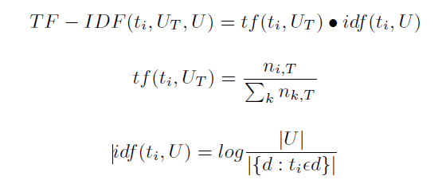
Recommendation Recommend Restaurants based on the User Profile.
Query-based retrieval and role-based recommendation are then implemented using Lucene's standard retrieval function, with the target user's profile matrix serving as the search query in the case of the latter.

Slide 9


Boolean Query Generation Query Generation for Recommendation.
User Profile
User ID : DKPqjzE-I6a0vsvYI7GDrQ
Category :Thai
Business ID:[ueoRWPGrSoZizl1ngBghqg, 2uRM8Et0uJVl8u1jSnmuKw]
Count :2
Range :2
Sample Query Outline
+cat:Thai +prange:[2.0 TO 3.0] +stars:[5.0 TO 5.0] +stars:[4.5 TO 4.5]
+stars:[4.0 TO 4.0] -bid:ueoRWPGrSoZizl1ngBghqg -bid:2uRM8Et0uJVl8u1jSnmuKw

Slide 10

Weighted Query Generation Weighted Query Generation for Overall Recommendation.
1
2
3
User ID : DKPqjzE-I6a0vsvYI7GDrQ
Category :Thai
Business ID:[ueoRWPGrSoZizl1ngBghqg, 2uRM8Et0uJVl8u1jSnmuKw]
Count :4
Range :2
User ID : DKPqjzE-I6a0vsvYI7GDrQ
Category : Mexican
Business ID:[ueoRWPGrSoZizl1ngBghqg, 2uRM8Et0uJVl8u1jSnmuKw]
Count :3
Range :2
User ID : fsasdkjf-I6a0vsvYI7GDrQ
Category : American
Business ID:[ueoRWPGrSoZizl1ngBghqg, 2uRM8Et0uJVl8u1jSnmuKw]
Count :6
Range :3
R(W)_{3 >} R(W)_{1 >} R(W)₂
R = R(W)₃ ₊ R(W)₁ ₊ R(W)₂

Slide 11

Evaluation Metrics Mean Average Precision.
Evaluation is based on whether User Visited business that are in Testing dataset are recommended by our model.
User visited Business
Training Data
Test Data
No. of business Recommended are User Visited
Precision = ----------------------------------------------------------
Total no. of Recommendations

Slide 12

Ground Truth Generation – Technique 1 Ground Truth for User Recommendation Evaluation.
Generated User ID and Business ID of the businesses visited by he User.
User :"oRWp73EAzos724vOY4qB6Q"
Business : ["4hG2j_ibsNblDgqei05U_g", "A5Rkh7UymKm0_Rxm9K2PJw", "K7lWdNUhCbcnEvI0NhGewg", "g8OnV26ywJlZpezdBnOWUQ", "5shgJB7a-2_gdnzc0gsOtg"]
User :"ZY7FsuDspS0dk8WXp9UXyw“
Business : ["ZrXYLXcEcDvYYBErmafobg", "O7ot_LMlCfLpOP9tBqeNfw", "ZO3ihx5FOObI_uCgin4x8w", "UBQRhqRMW4Sk7kSZvZ1iAQ", "ohEnmKpF7i2_ujme1p_vUQ", "pjpUOlJLlkIxBZ5BquA2PA", "wl0QZqAzr1DelslQ02JGCQ", "hCsJv234v62MgdsUU1j8dQ", "Gz9SlLqxS6wnxPvgdOQNrA", "t5nyOtnEv455rShOS_g3RA", "PVTfzxu7of57zo1jZwEzkg"]
Split the Business Data into 2 parts as Training and Test Set.
Evaluated to check whether the Test business ID

Slide 13
Results – Technique 1 Ground Truth for User Recommendation Evaluation.
User | Actual B. ID | B. ID [Used to generate User Profile] | B. ID [Test Recommended –Top 10] | Truth Table
1 | ["C0Gy3NUOKCh0ffMzaXhXlQ", "806kkDGaRCJ4lZLRcEf-iw", "fz8wgxbKnwa_fdk_W5M4Ow", "m4PW-GMc8JOU5nmMYncu-Q", "Jl2MIN70I2DGw8KhVp6g7Q", "3f0-EXRF0oy6NDsFh9TJKA"] | ["C0Gy3NUOKCh0ffMzaXhXlQ", "806kkDGaRCJ4lZLRcEf-iw","fz8wgxbKnwa_fdk_W5M4Ow","Jl2MIN70I2DGw8KhVp6g7Q“] | [“3f0-EXRF0oy6NDsFh9TJKA"] | T
2 | ["C0Gy3NUOKCh0ffMzaXhXlQ", "806kkDGaRCJ4lZLRcEf-iw", "fz8wgxbKnwa_fdk_W5M4Ow", "m4PW-GMc8JOU5nmMYncu-Q", "Jl2MIN70I2DGw8KhVp6g7Q", "3f0-EXRF0oy6NDsFh9TJKA"] | ["C0Gy3NUOKCh0ffMzaXhXlQ", "806kkDGaRCJ4lZLRcEf-iw", "fz8wgxbKnwa_fdk_W5M4Ow", "m4PW-GMc8JOU5nmMYncu-Q“] | - | F
Truth
Accuracy = --------------------
Truth + False

Slide 14
Ground Truth Generation – Technique 2 Ground Truth for User Recommendation Evaluation using MAP.
Generated User ID and Business ID of the businesses visited by he User.
User :"oRWp73EAzos724vOY4qB6Q"
Business : ["4hG2j_ibsNblDgqei05U_g", "A5Rkh7UymKm0_Rxm9K2PJw", "K7lWdNUhCbcnEvI0NhGewg", "g8OnV26ywJlZpezdBnOWUQ", "5shgJB7a-2_gdnzc0gsOtg"]
User :"ZY7FsuDspS0dk8WXp9UXyw“
Business : ["ZrXYLXcEcDvYYBErmafobg", "O7ot_LMlCfLpOP9tBqeNfw", "ZO3ihx5FOObI_uCgin4x8w", "UBQRhqRMW4Sk7kSZvZ1iAQ", "ohEnmKpF7i2_ujme1p_vUQ", "pjpUOlJLlkIxBZ5BquA2PA", "wl0QZqAzr1DelslQ02JGCQ", "hCsJv234v62MgdsUU1j8dQ", "Gz9SlLqxS6wnxPvgdOQNrA", "t5nyOtnEv455rShOS_g3RA", "PVTfzxu7of57zo1jZwEzkg"]
Instead of dividing the Business data into test and train divide data into several clusters observe how the business are appearing for each query in the search results calculate Average Precision and Mean Average Precision.
Performed evaluations accordingly for different varieties of Query in order to achieve better results.

Slide 15
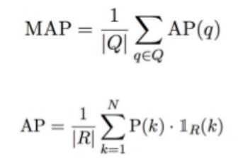
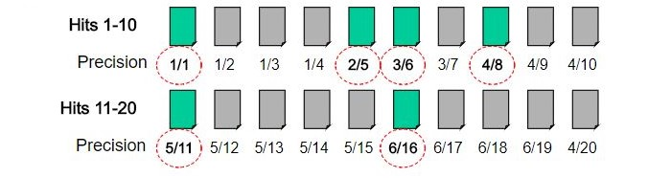
Ground Truth Generation – Technique 2 Ground Truth for User Recommendation Evaluation using MAP.
MAP = Sum of Average Precision per query/Total no.of Queries
Sum of Precision per recommended business
AP = -----------------------------------------------------------
Total no of user visited business
Q: Boolean Query Generated for each userId
R: User Visited Business (Ground truth)
k: Recommended Business
P(k): Precison of each Recommended Business

Slide 16
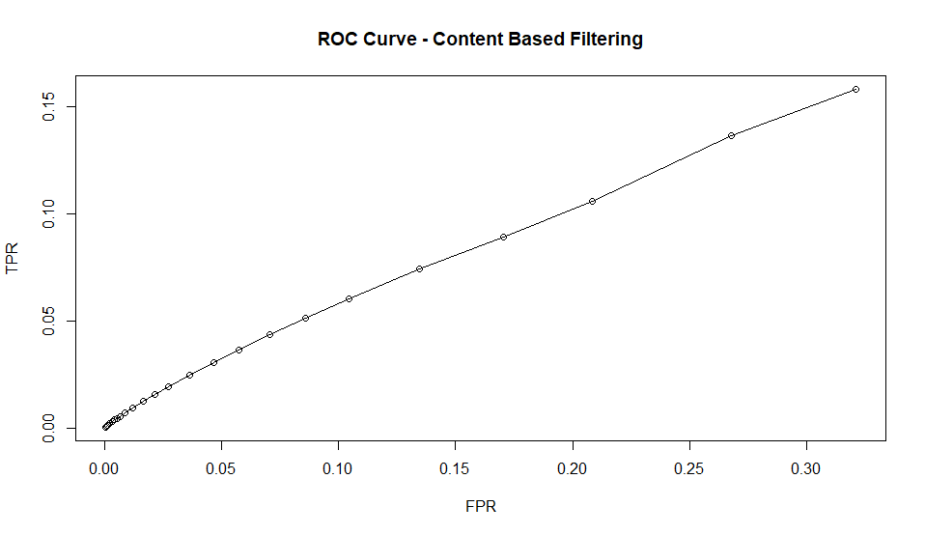
Task 1 Approach 1 – ROC Curve and MAP
Mean Average Precision : 0.000695

Slide 17
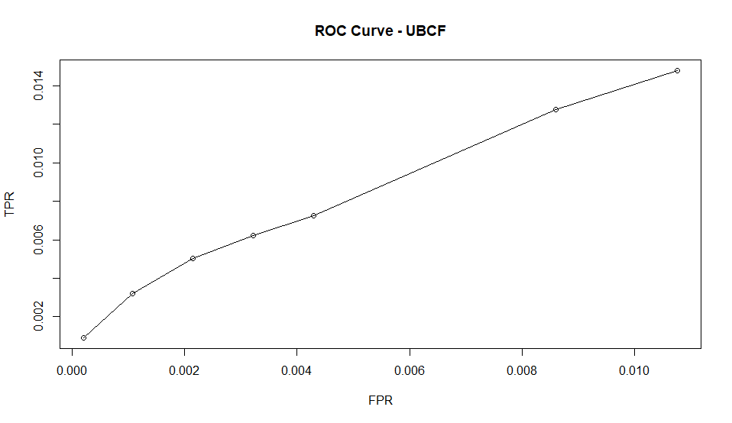
Task 1 Approach 2 – User based collaborative filtering– ROC Curve and MAP
Mean Average Precision : 0.004128

Slide 18
Results – Technique 2 Ground Truth for User Recommendation Evaluation – MAP .

Slide 19
A final point of note is that adding another recommendation can never decrease your AP score
Using MAP to evaluate a recommender algorithm implies that you are treating the recommendation like a ranking task. This often makes perfect sense since a user has a finite amount of time and attention and we want to show the top recommendations first and maybe market them more aggressively.

Slide 20
TASK 2 : Predicting most famous dishes in a restaurant
Predicting dishes after performing the sentiment analysis using Information retrieval system.

Slide 21

Why is this Important ?
To understand which are the best dishes served by that particular restaurant
We save user’s hassle of reading all the reviews and tips manually as it is time consuming and maybe futile approach based on the total number of reviews.
To eliminate this hectic process, we are predicting the famous dishes of a particular business by analyzing the reviews and tips.
This is a crowd sourced approach as we are using all the data available in the reviews and tips based on the content written by the user.
Due to the large size of the dataset, we have restricted to popular Mexican dishes and restaurants across USA serving that cuisine.

Slide 22
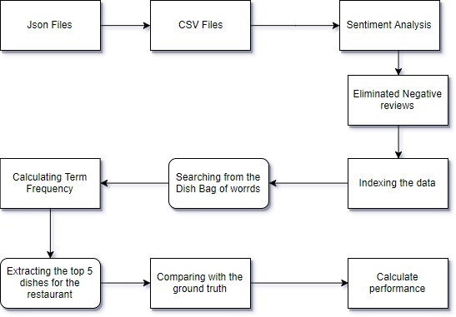
Flow Chart

Slide 23
Data Preprocessing Data Preprocessing for Lucene
Extracted reviews and tips for each business serving the mexican cuisine.
Performed sentiment analysis on the available text to generate a score which will help us remove all the reviews or tips which have a negative score.
Not only based on the review rating as there exists situation where people like the food but not the service or ambience.
Eg: I ordered carne asada, fish, & chicken tacos. Tacos are really small & over cooked. Was really disappointed, expected a lot based on the reviews I read.You're better off going to a taco truck. I really hate how over priced tacos are now. Wouldn't mind paying $2-3, but at least give me what I'm paying for.
Total no. of reviews and tips before filtering: 60827
Total no. of reviews and tips after filtering: 54486

Slide 24
Index Generation
Indexing the data using the following parameters:
Business ID
User ID
Review ID
Rating stars
Sentiment analysis score
Review text
Indexed the data using Lucene indexing and then searched across the documents by building query.

Slide 25
Query Generation Query Generation for Recommendation.
We first extract the unique businesses of the dataset using Terms from the Lucene dataset.
The general QueryParser for dishes which just have a single word in it.
For dishes with more than 1 word, we have used PhraseQueryBuilder.
Then, we use Boolean query to combine the results and get the best dishes for all the businesses.

Slide 26
Predicting the best Mexican dish
Manually created a Mexican dish list from many sources available on the internet.
Eliminated the business which have reviews less than 50, due to lack of enough data to compute the top dishes.
Obtained the number of occurrence of each dish in the dish list and obtained a score.

Slide 27

Search Approach
EXACT MATCH:
Here, we try to match the exact words as present in the dish bag of words which may or may not be present in the review text.
PARTIAL MATCH:
On a set of data, we extracted the dish name and applied stemming algorithm to get the name of dishes.
This ensured that different variants including plural forms as well as singular forms are considered as a single entity.
We also plan to use fuzzy search to deal with spelling mistakes

Slide 28
Ranking the data
Sorted the dishes basing on the score for a particular business as per the term frequency score.
This will be used to retrieve all the top 5 dishes of the restaurants.
Eliminated all the dishes that have a score of 1 as a single occurrence is not useful enough.

Slide 29
Evaluation of this approach

Slide 30
Evaluation Technique
Since, this is an Unsupervised learning approach it is difficult to evaluate the results as there are no labelled train data sets available.
We have created a manually filtered result of top dishes for 50 restaurants to compare the performance of the algorithm.

Slide 31
Ground Truth Generation
To generate ground truth, we manually filtered the dishes out of 50 restaurants serving Mexican dishes.
We checked the tone of the review to manually estimate the sentiments and filter out all those which seemed negative.
We did POS Tagging and extracted the noun phrases from the review text and also stemmed the words.
Thus, we received top dishes for 50 Mexican restaurants.

Slide 32
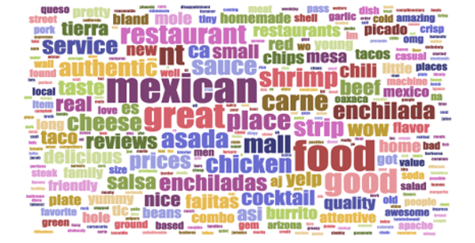
Word cloud

Slide 33
Comparision for Partial Match and Exact Match
Famous dishes by manually analyzing from the reviews and word clouds:
Salsa, carne asada, enchiladas, tacos, shrimp
Partial Match
Salsa, enchiladas, tacos, chips, carne asada
Exact Match
Salsa, carne asada, chorizo, fajitas, tacos

Slide 34

EVALUATION APPROACH
Manually annotated the top 5 dishes for 50 business and calculated the prediction accuracy measure.
Prediction Accuracy is calculated for both Exact Match approach and Partial Match approach

Slide 35
Business_ID: EryvpcMxoaOr_BnQVMqQIg
Ground Truth: tacos, burrito, enchiladas, salsa, tortilla
Exact Match: tacos, salsa, burrito, guacamole, refried beans [3/5]
Partial Match: salsa, burrito, taco, tortilla, guacamole [4/5]
Business_ID: eul4wrpoczkobks93pxv5a
Ground Truth: chimichanga, lobster, enchiladas, tacos, margarita
Exact Match: salsa, tacos, enchiladas, shredded beef, fajitas [2/5]
Partial Match: salsa, enchilada, chimichanga, tacos, tortilla [3/5]

Slide 36
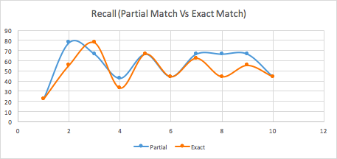
ACCURACY

Slide 37
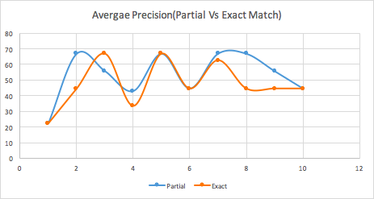
ACCURACY

Slide 38
ACCURACY
MAP (Top 10 business)
Exact Match - 43.56945
Partial Match - 47.365086
We can observe that Partial Match performs better than Exact Match
Tables and the data we used for this evaluation is in github.

Slide 39
Challenges:
The limitations of using a fixed bag of dishes list is that some restaurants have innovative dish names which might be different from their original dish names.
The prediction system fails to identify them and thus the dishes gets eliminated in spite of being popular enough to be classified it as best dish for that restaurant.

Slide 40

Future Scope
We can expand the bag of words set to include different cuisines so that we can support more and more restaurants on yelp and help users get information about the best dishes of that restaurants.
We can use Named-Entity Recognition to actually filter the dishes out instead of using the dish bag of words.

Slide 41
Work Distribution
ARUN - Extraction of data, Mongo db connector, Built user profile for task 1, Worked on the algorithm for recommending restaurants.
KEERTHI – Evaluation for Task 1, Generated ground truth, Query generation.
CHIRAG – Lucene Indexing, Query generation and worked on the algorithm to search for famous dishes.
JANANI – Evaluation for task 2, Generated ground truth, word clouds and sentiment analysis on reviews.

Slide 42


